Slide 1
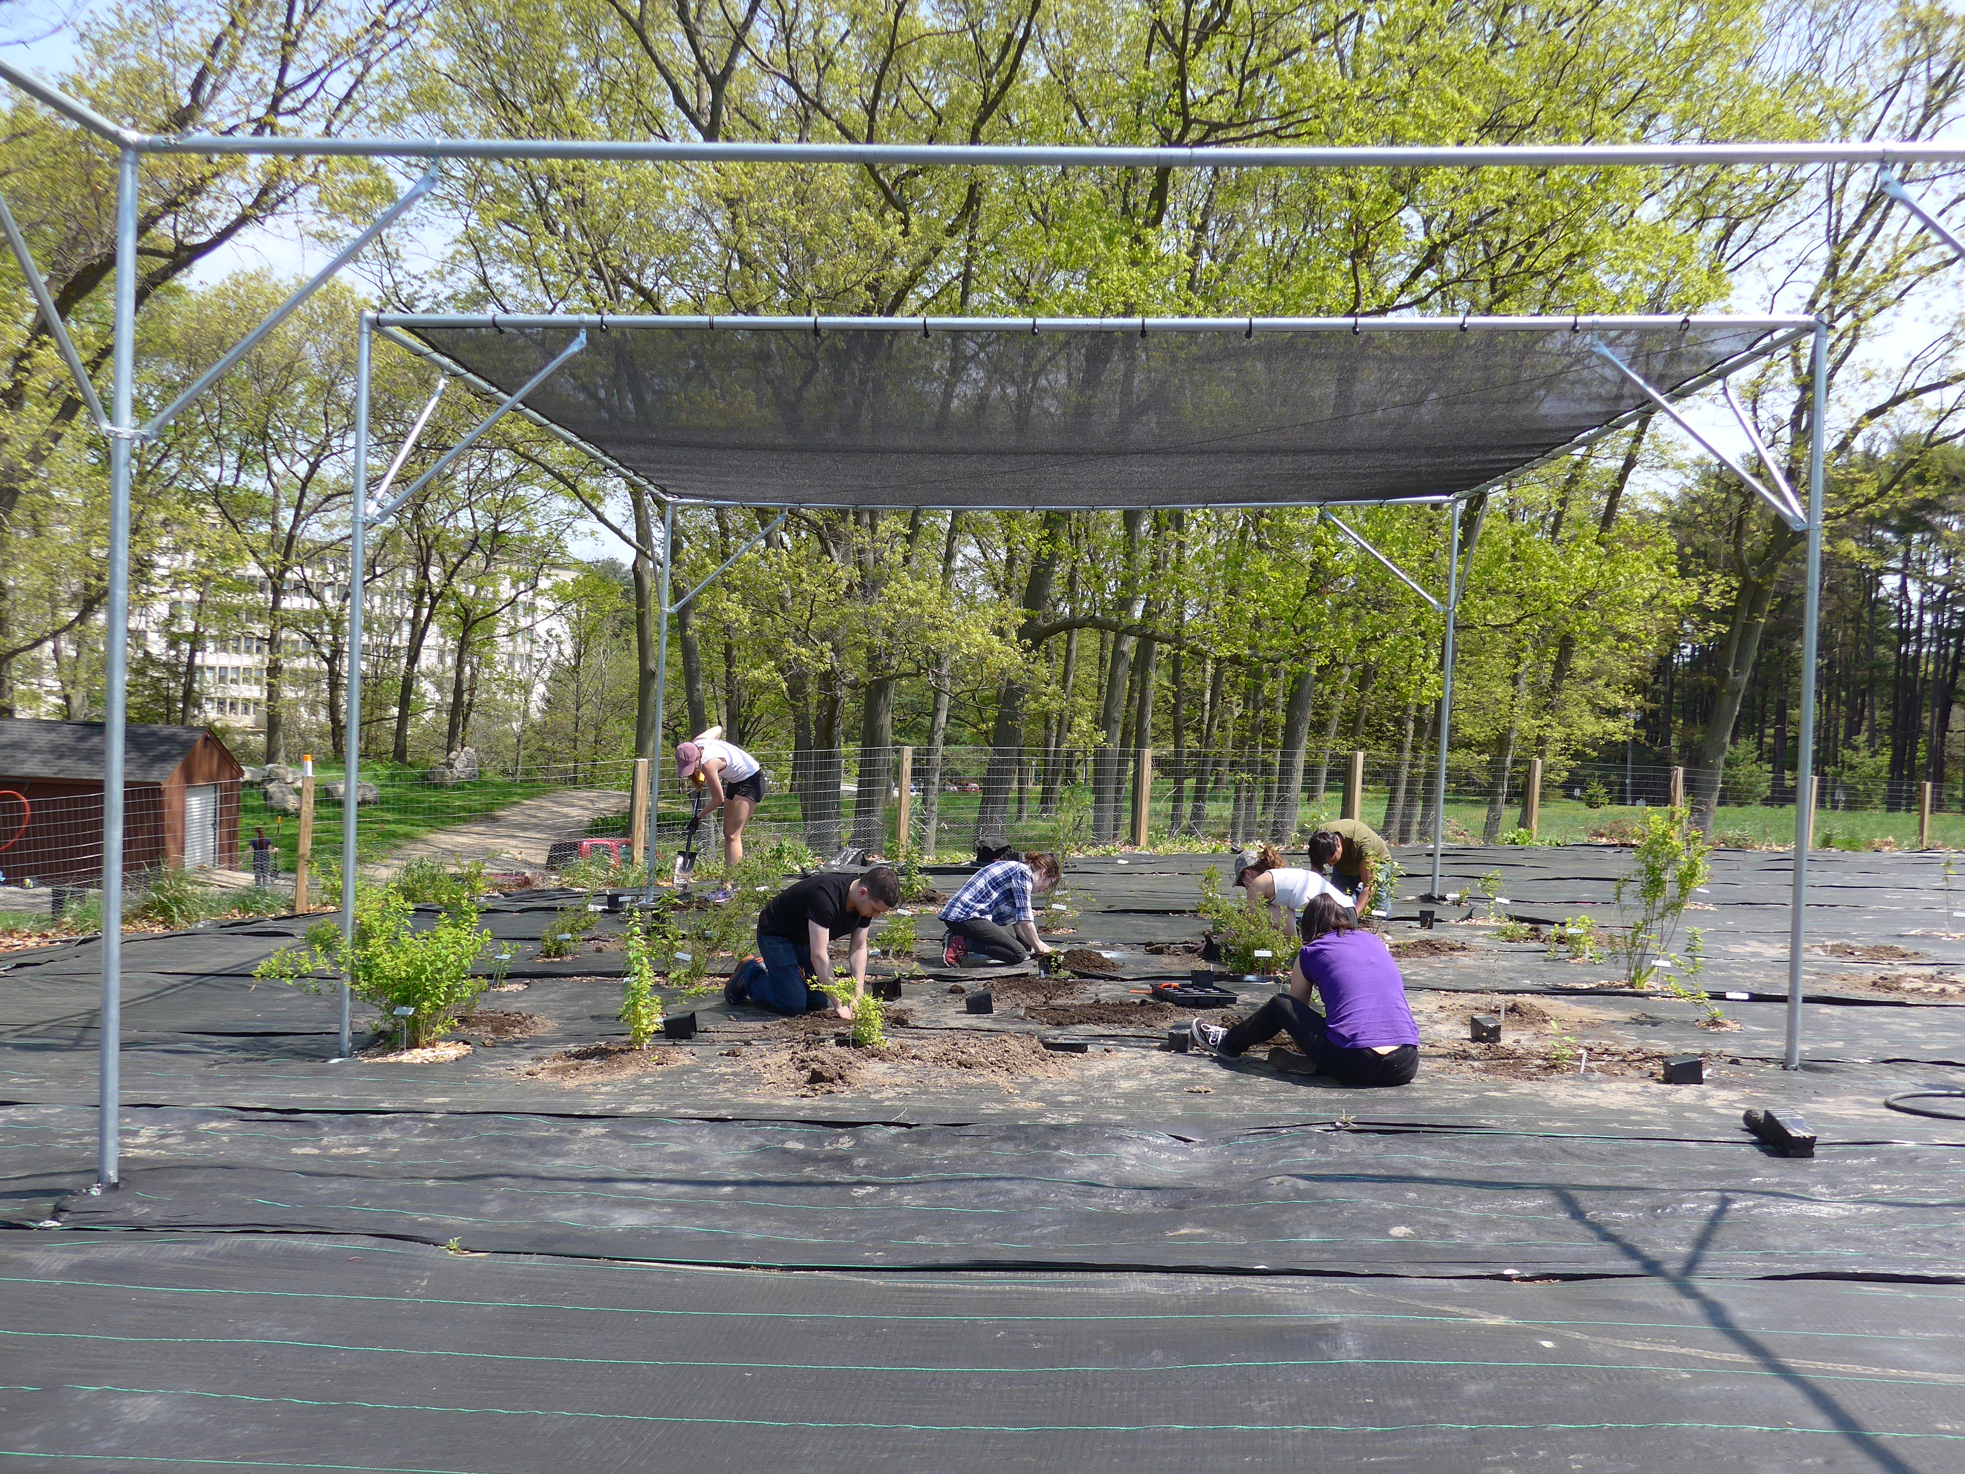
Wild Hell Garden
aka the Common Garden at Weld Hill

Slide 2
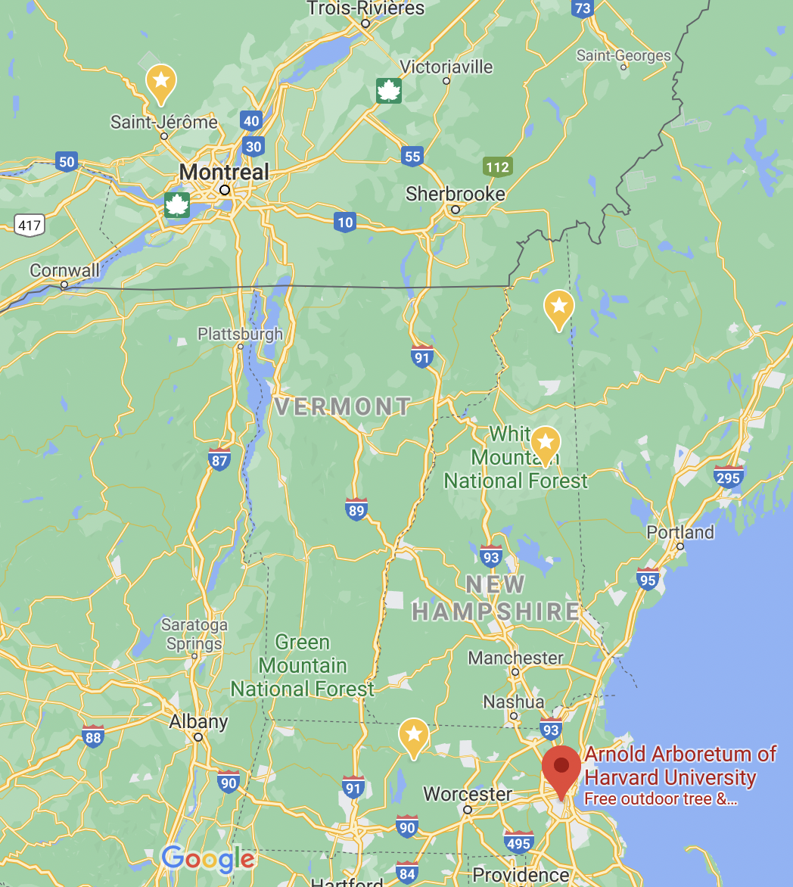
Saint-Hippolyte
46.1
Second College Grant
44.9
White Mountains
44.2
Harvard Forest
42.7
Arnold Arboretum
42.5

Slide 3
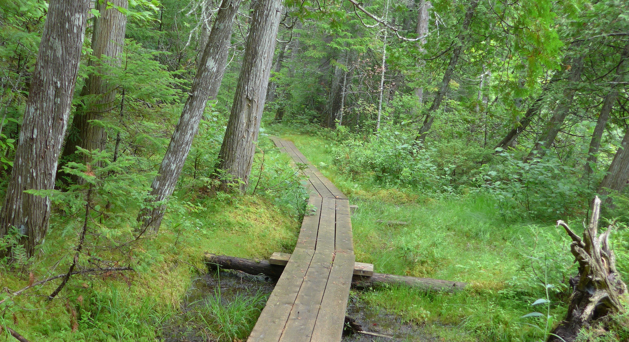
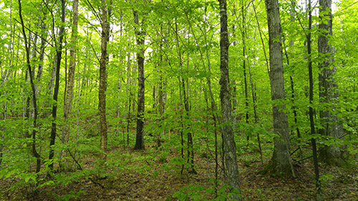
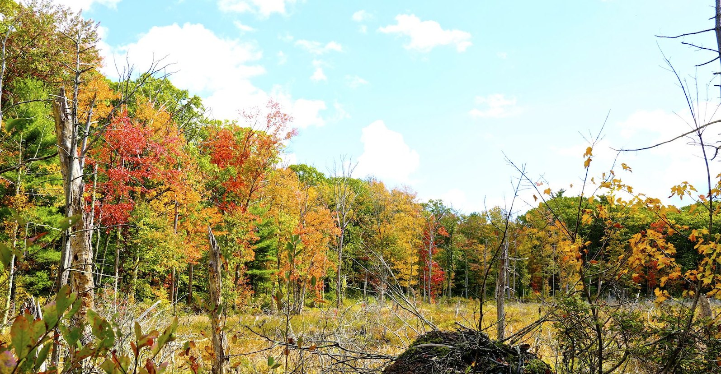
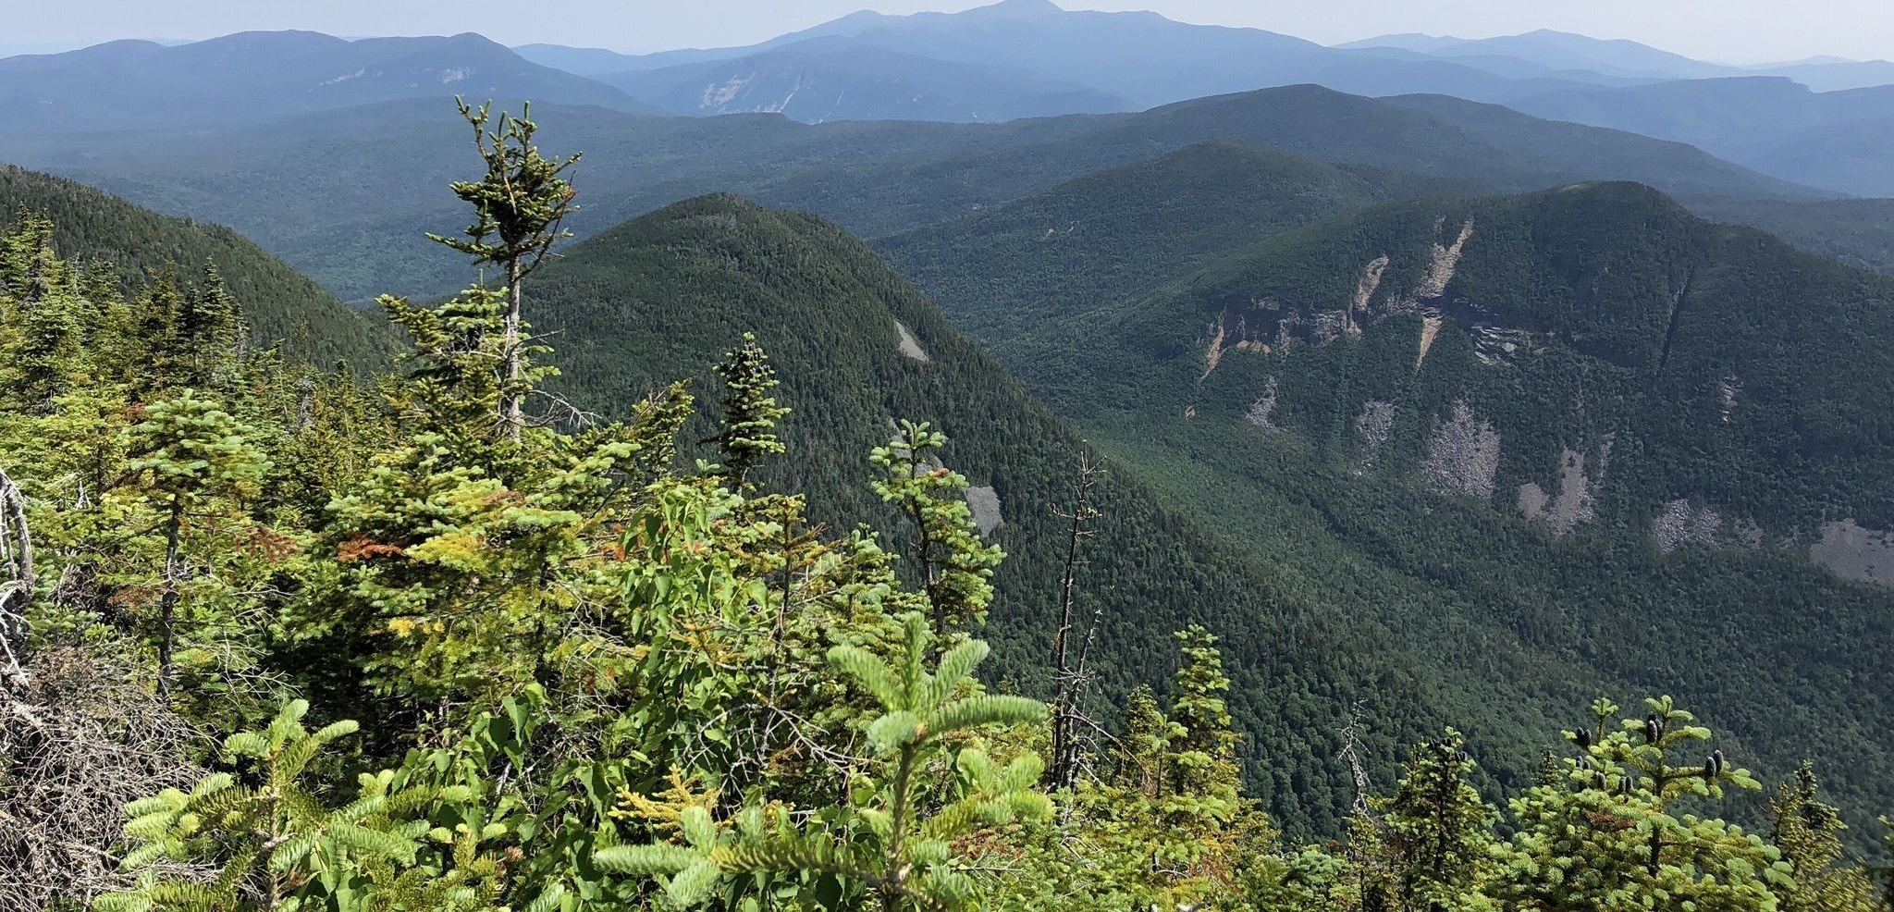
Saint-Hippolyte
Second College Grant
Harvard Forest
White Mountains

Slide 4
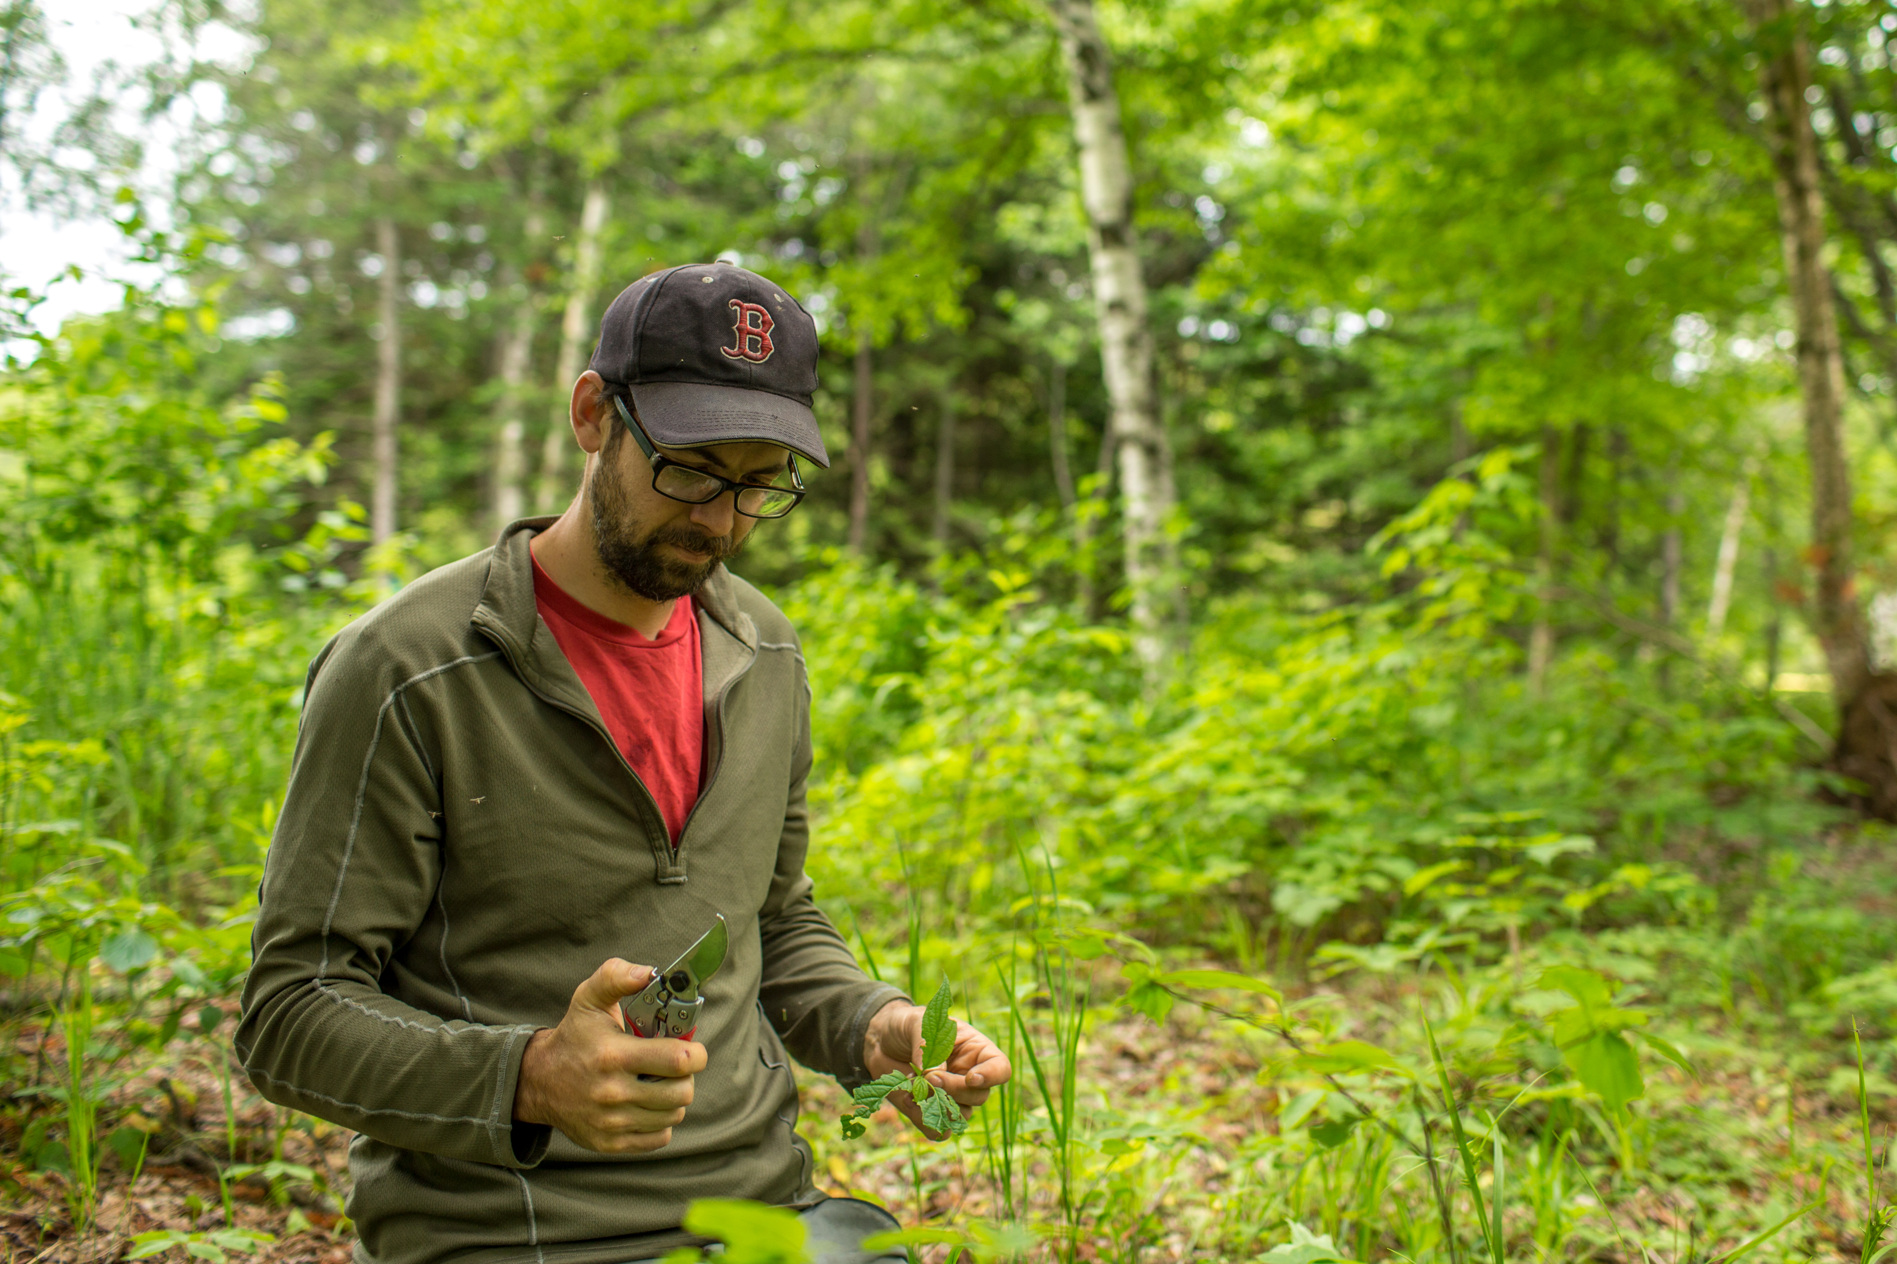
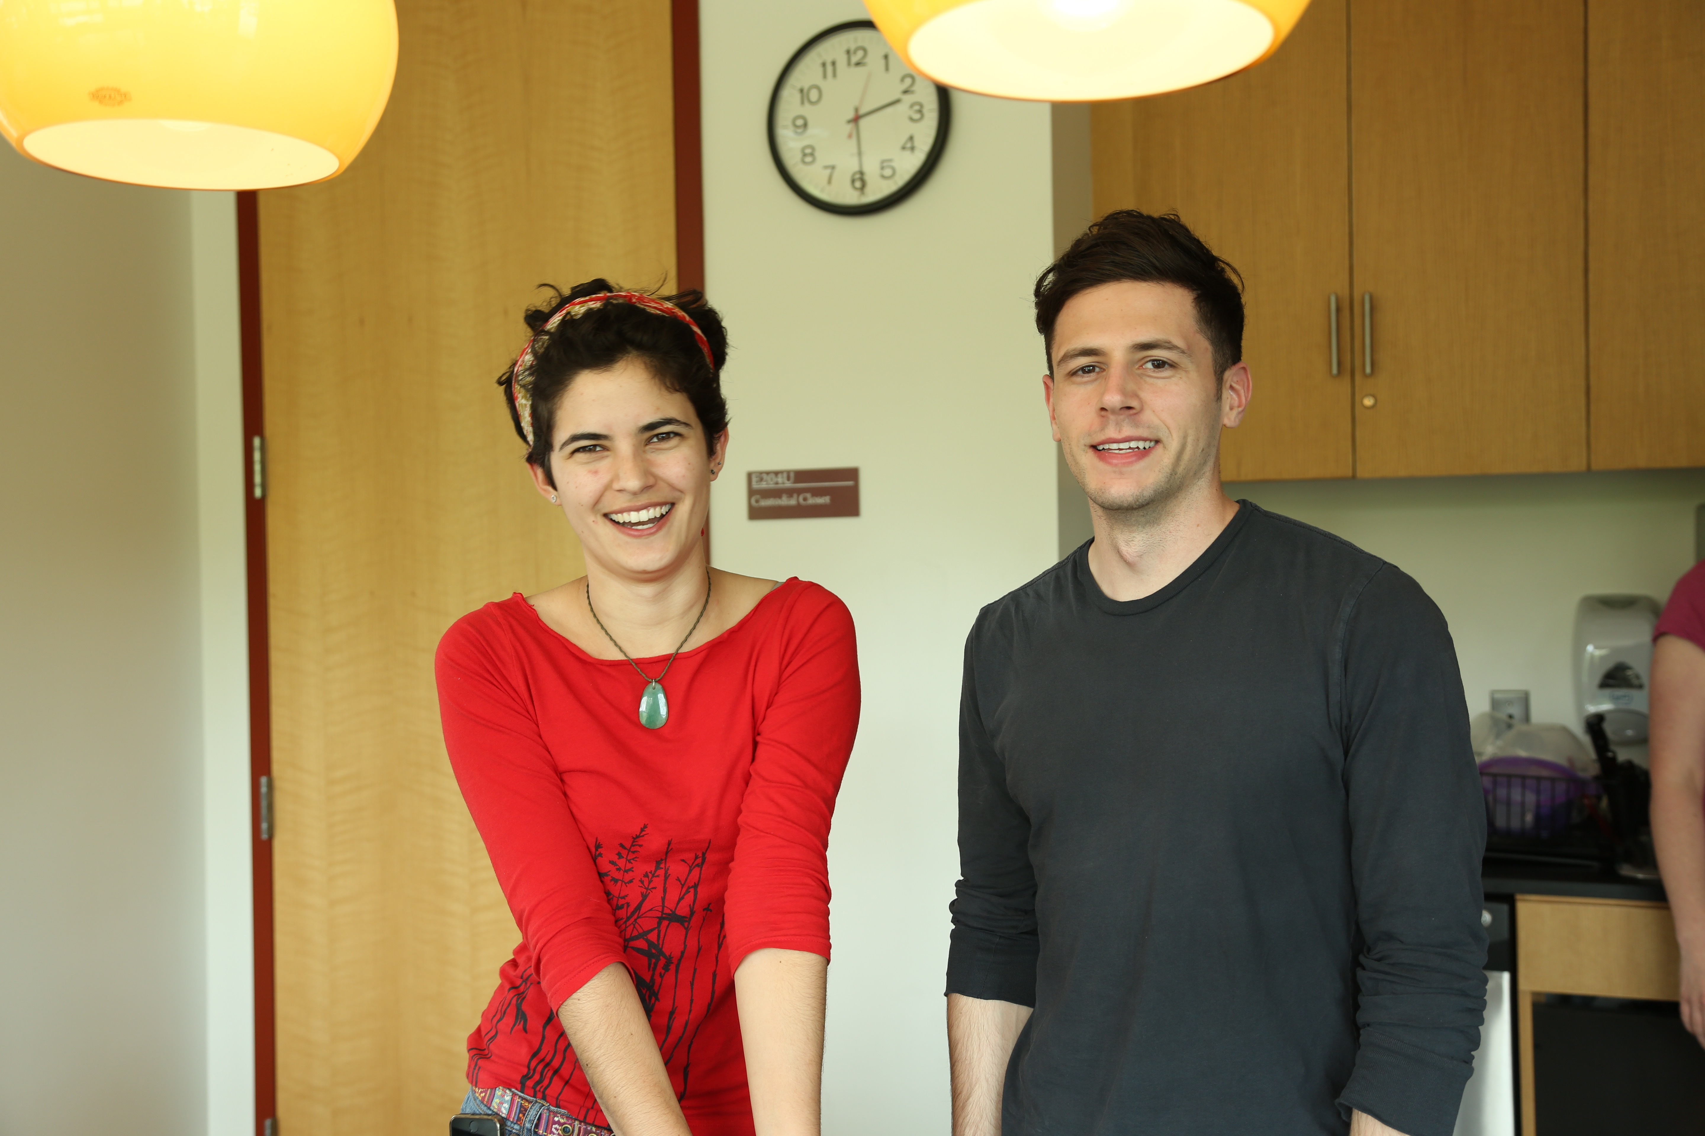
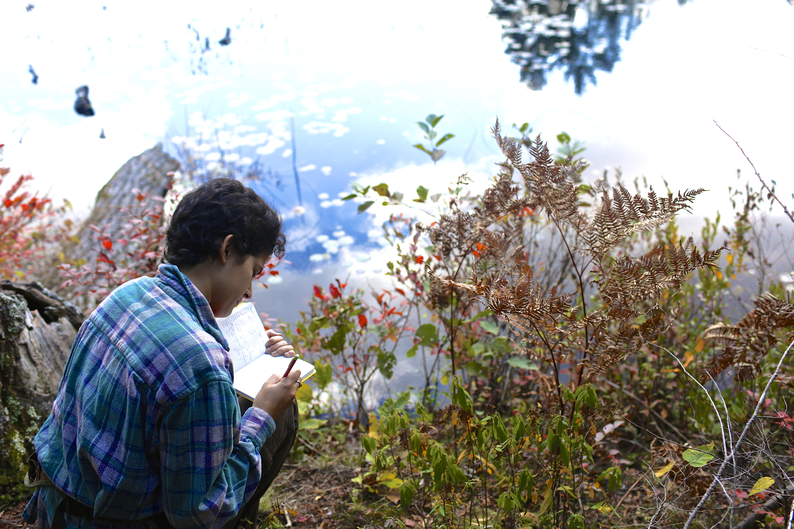

Slide 5
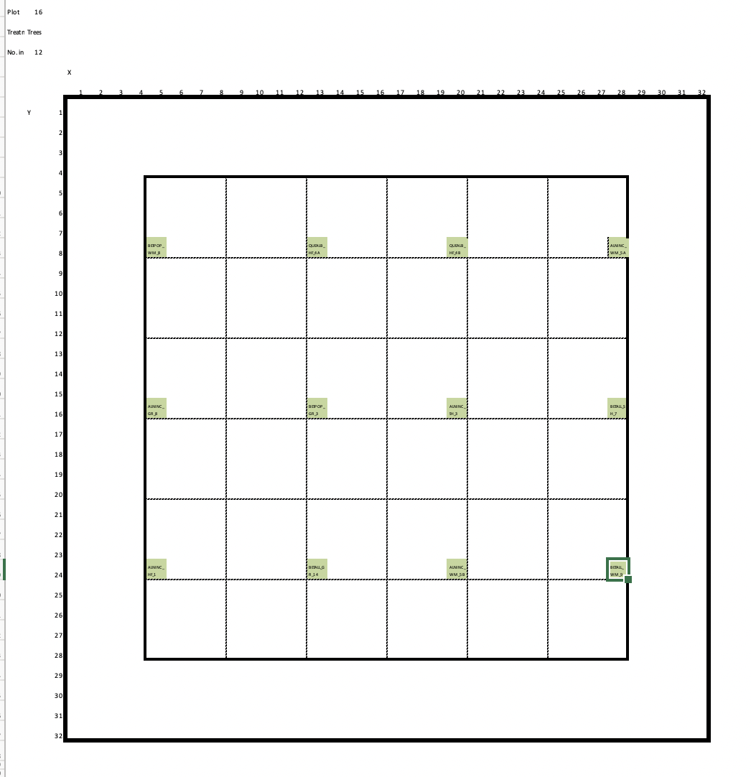
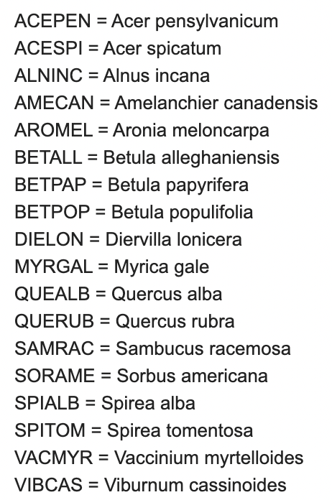
16 Plots, 4 Sites, 18 species

Slide 6
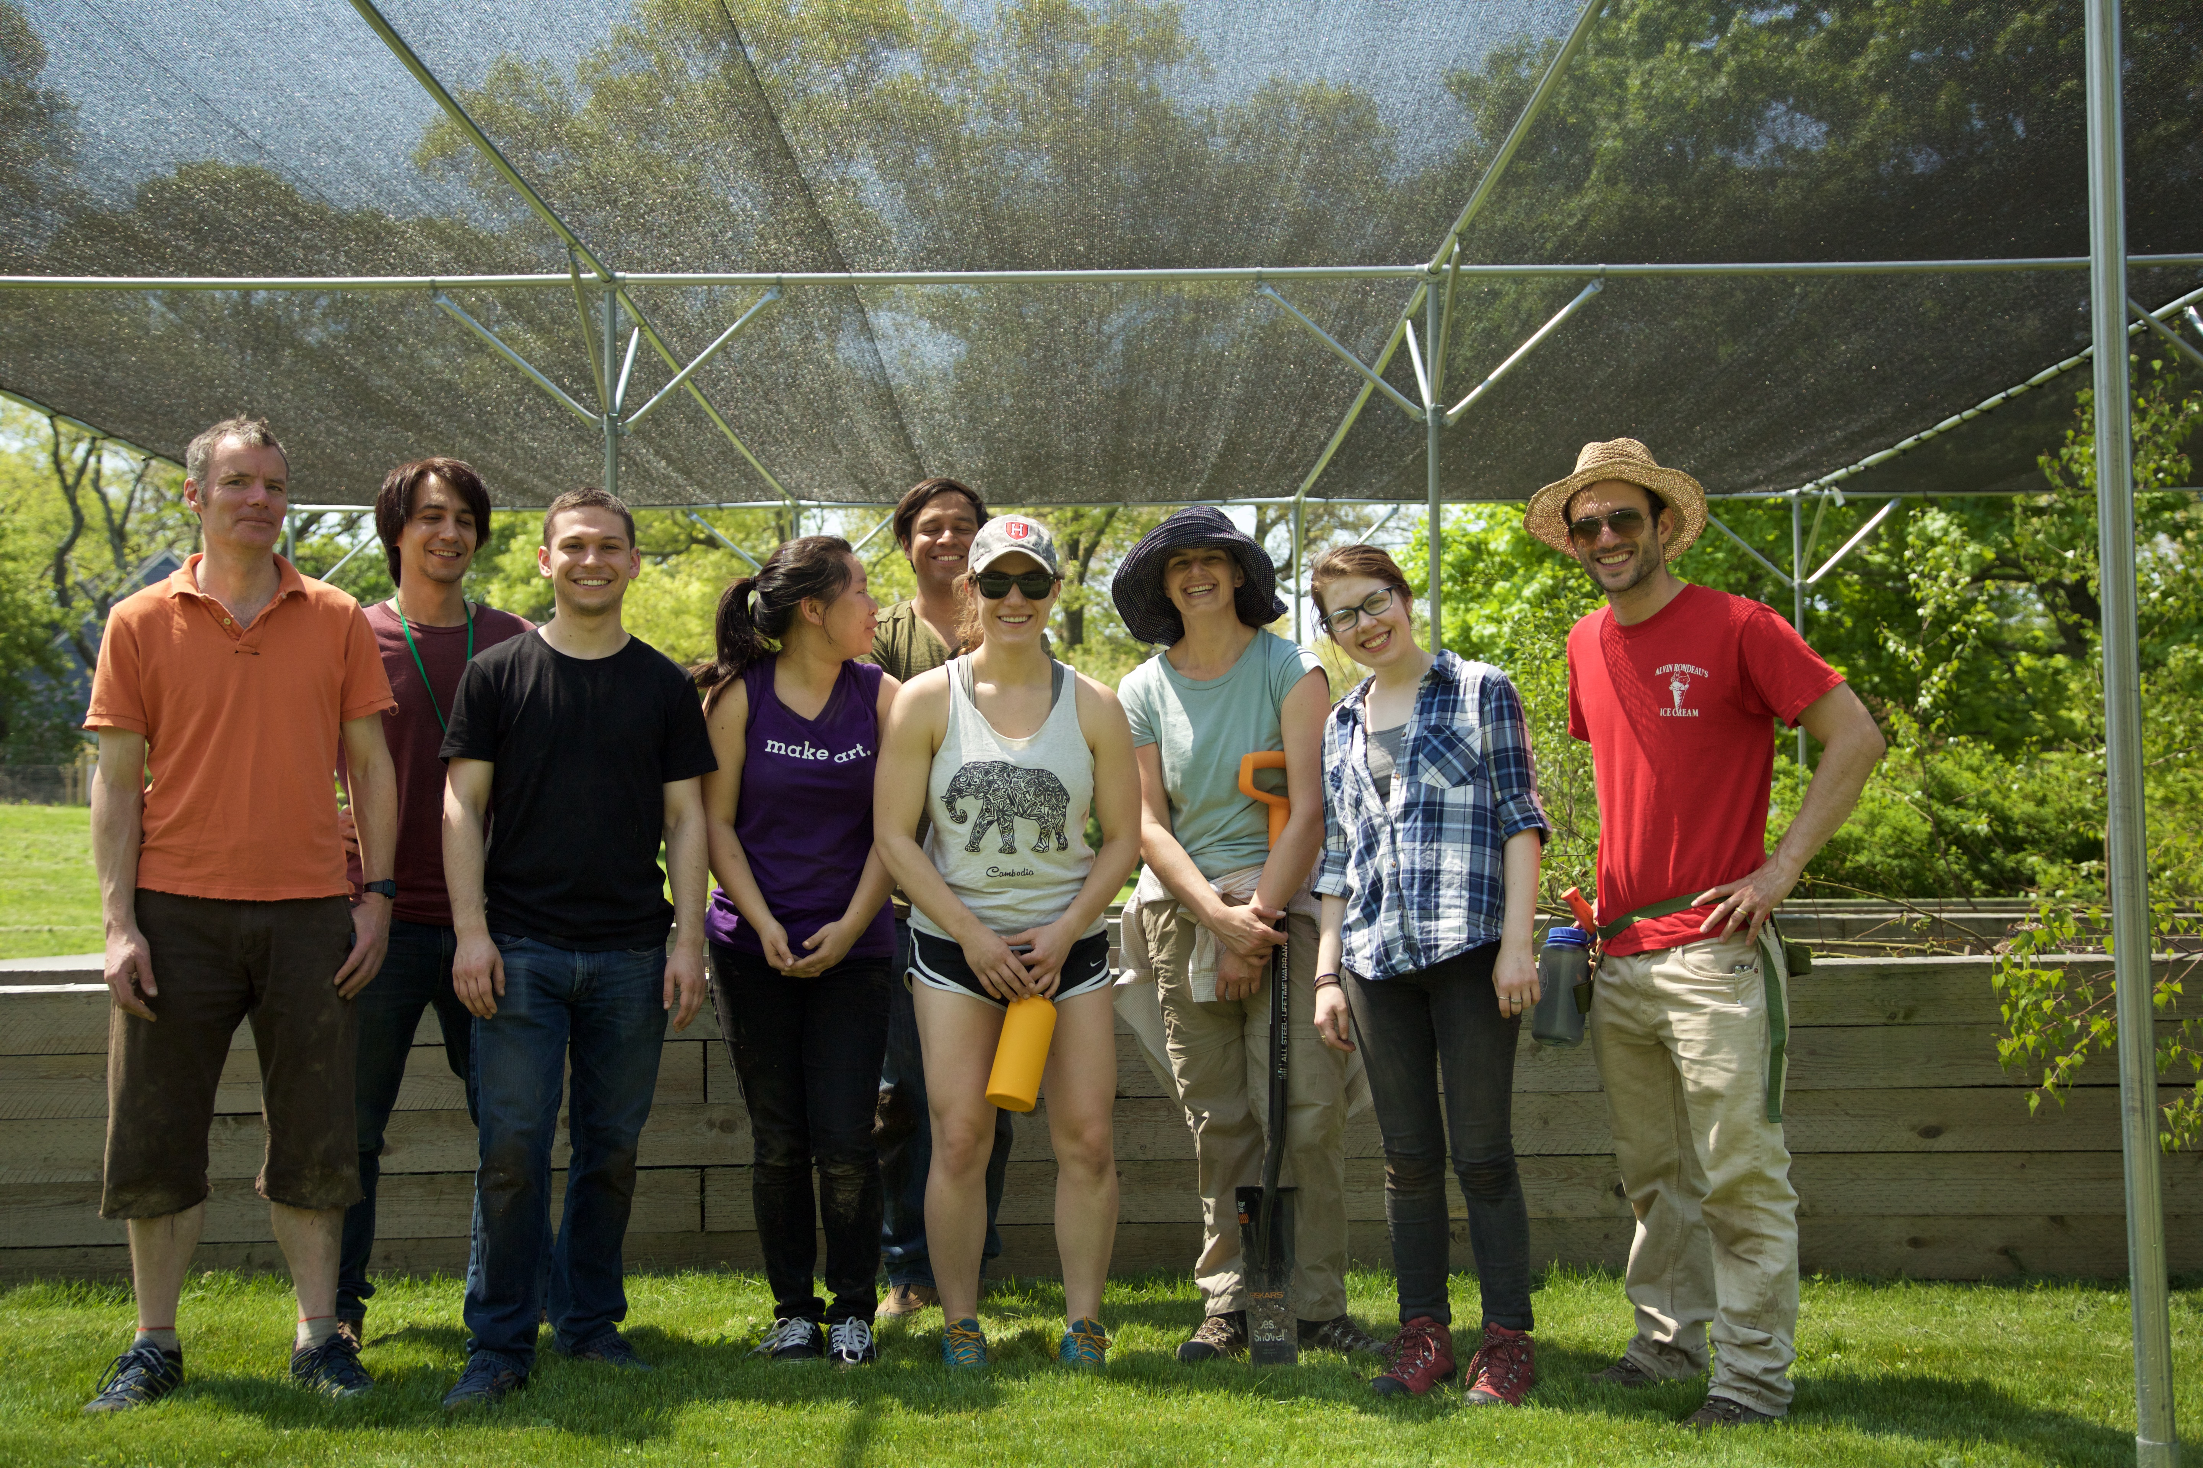
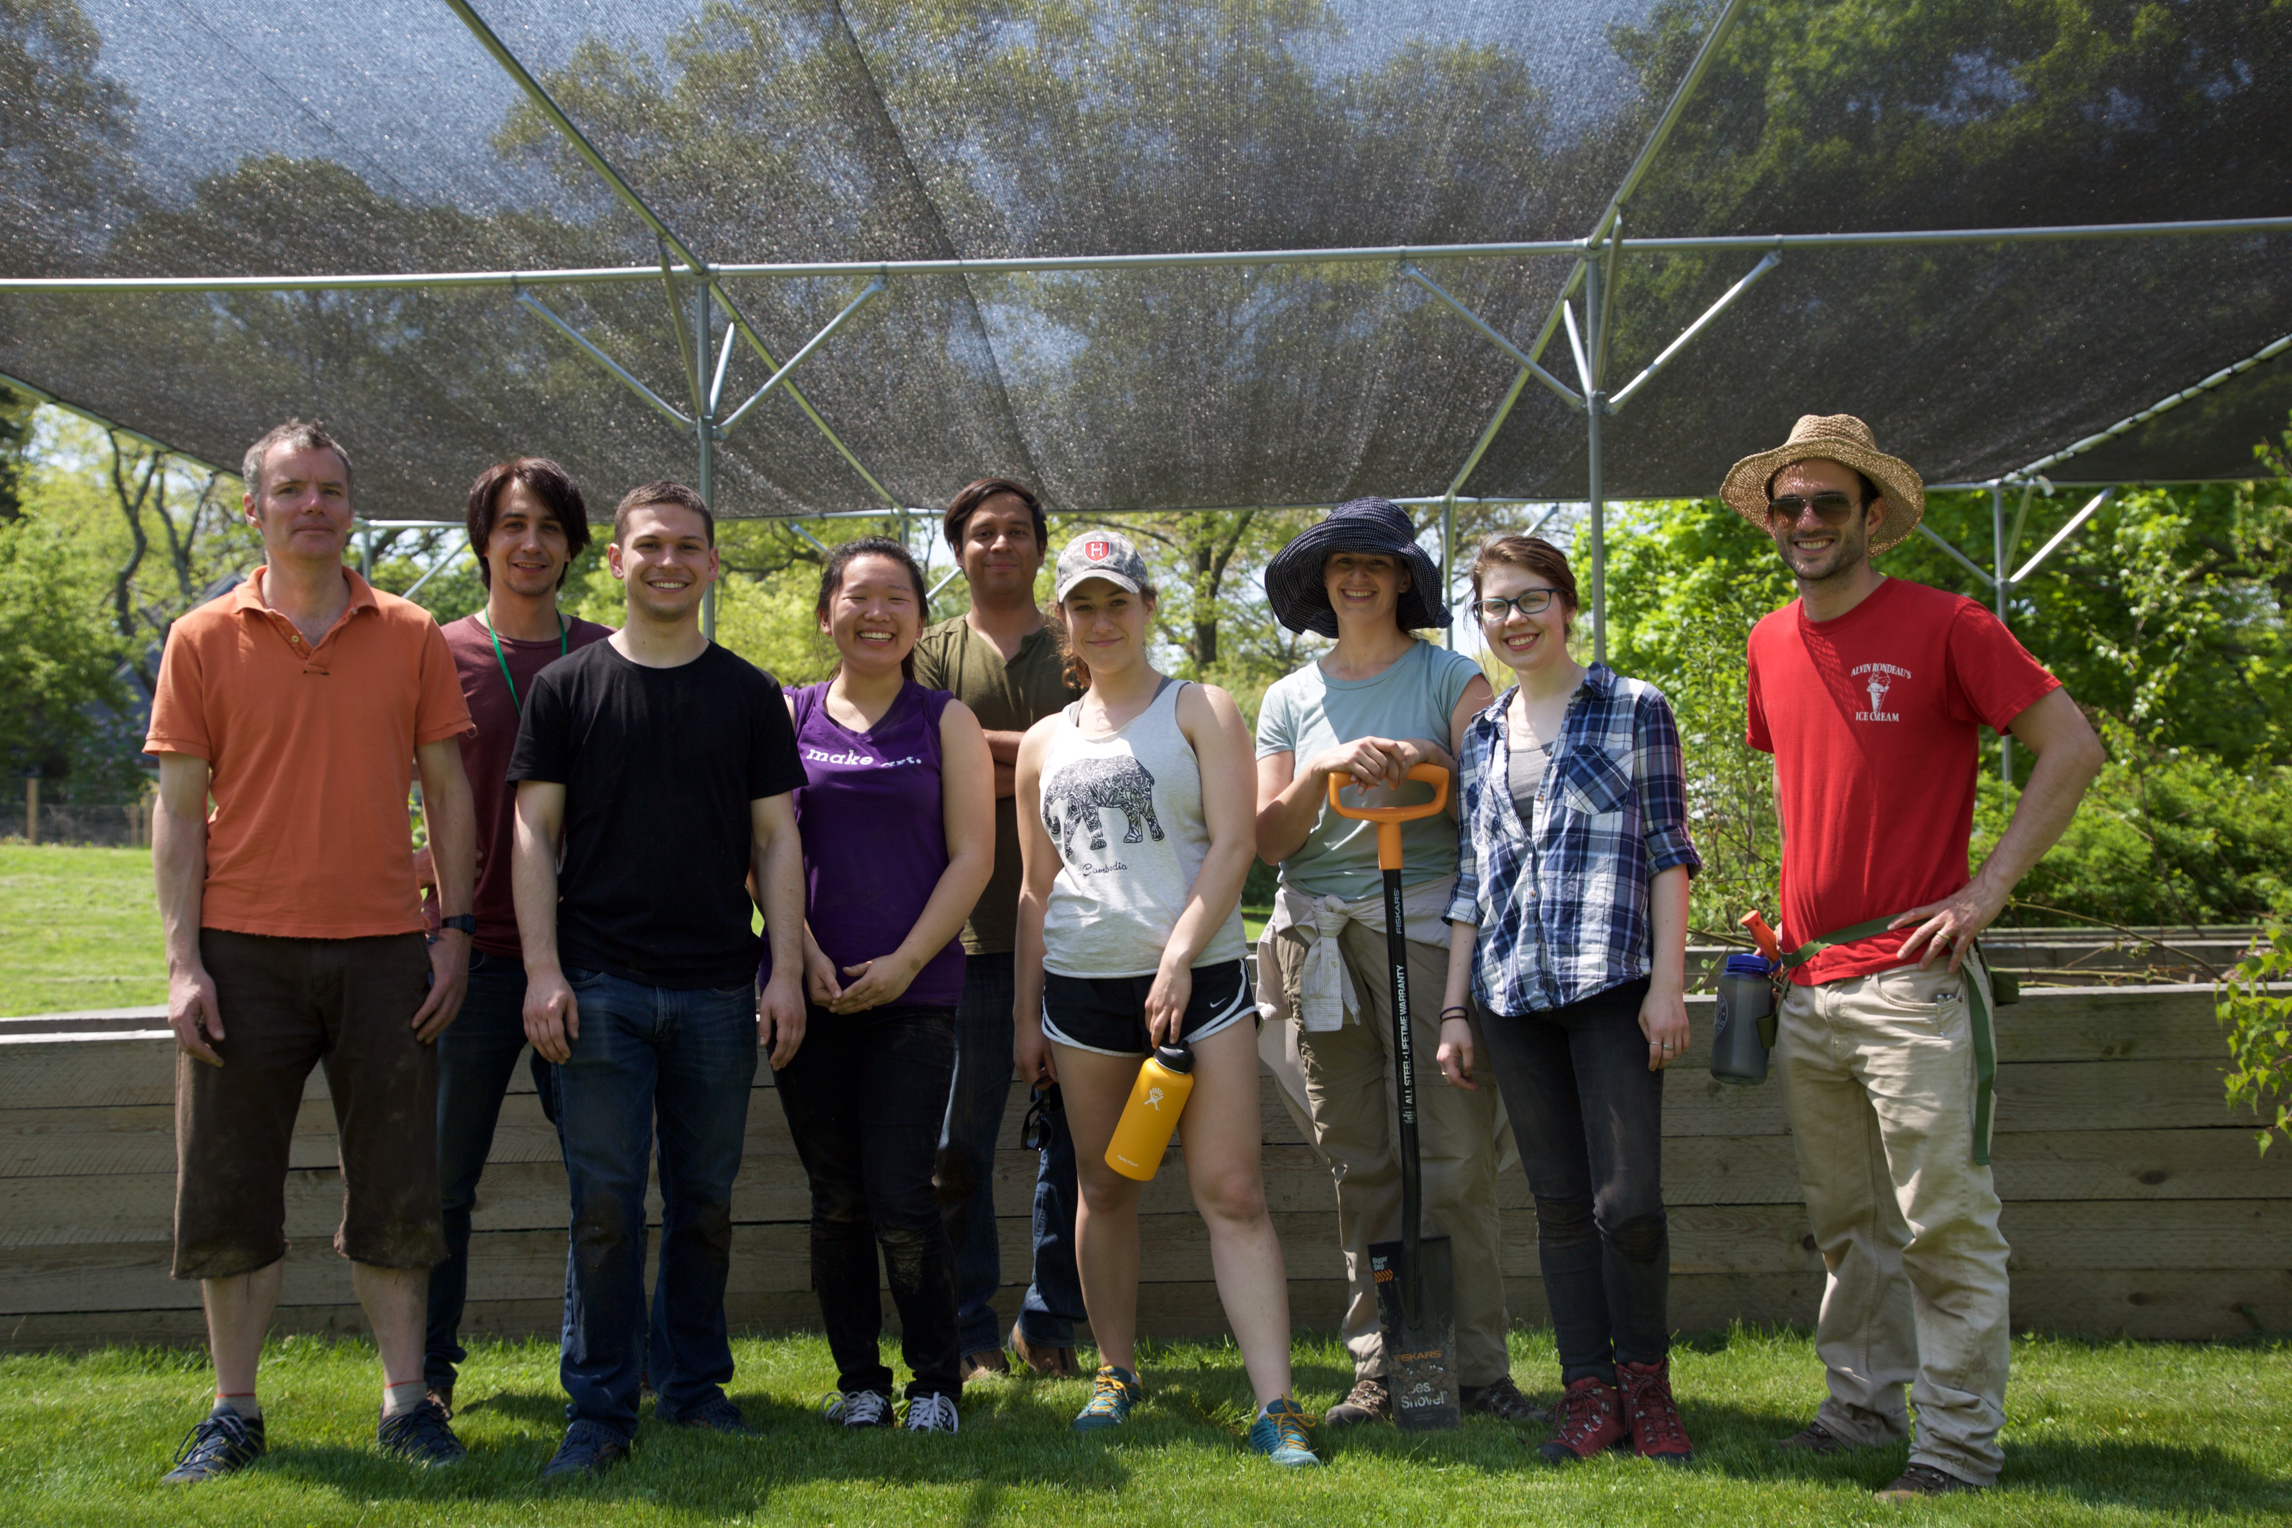
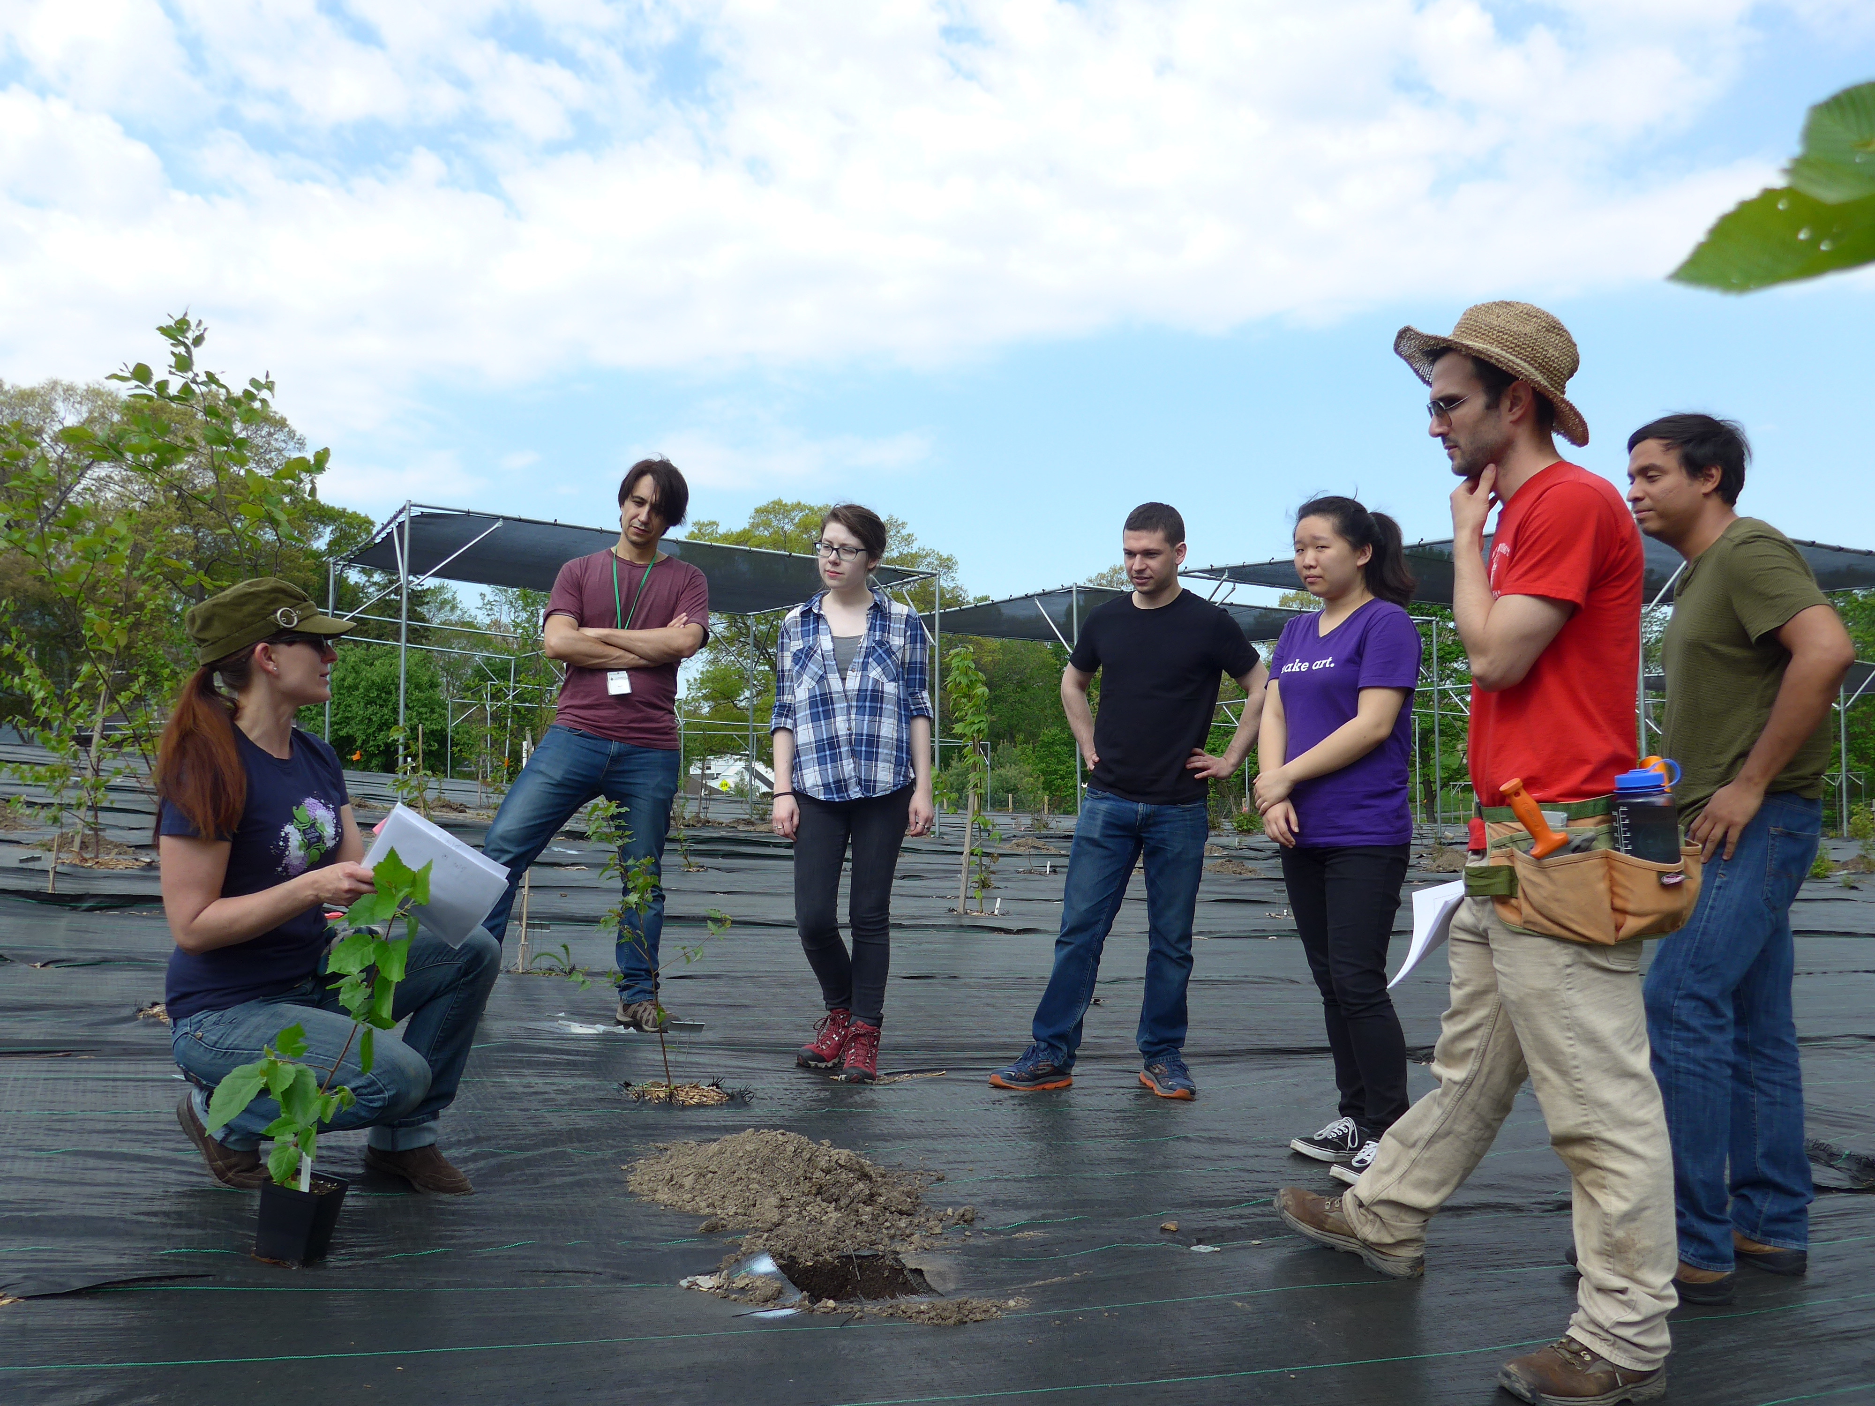
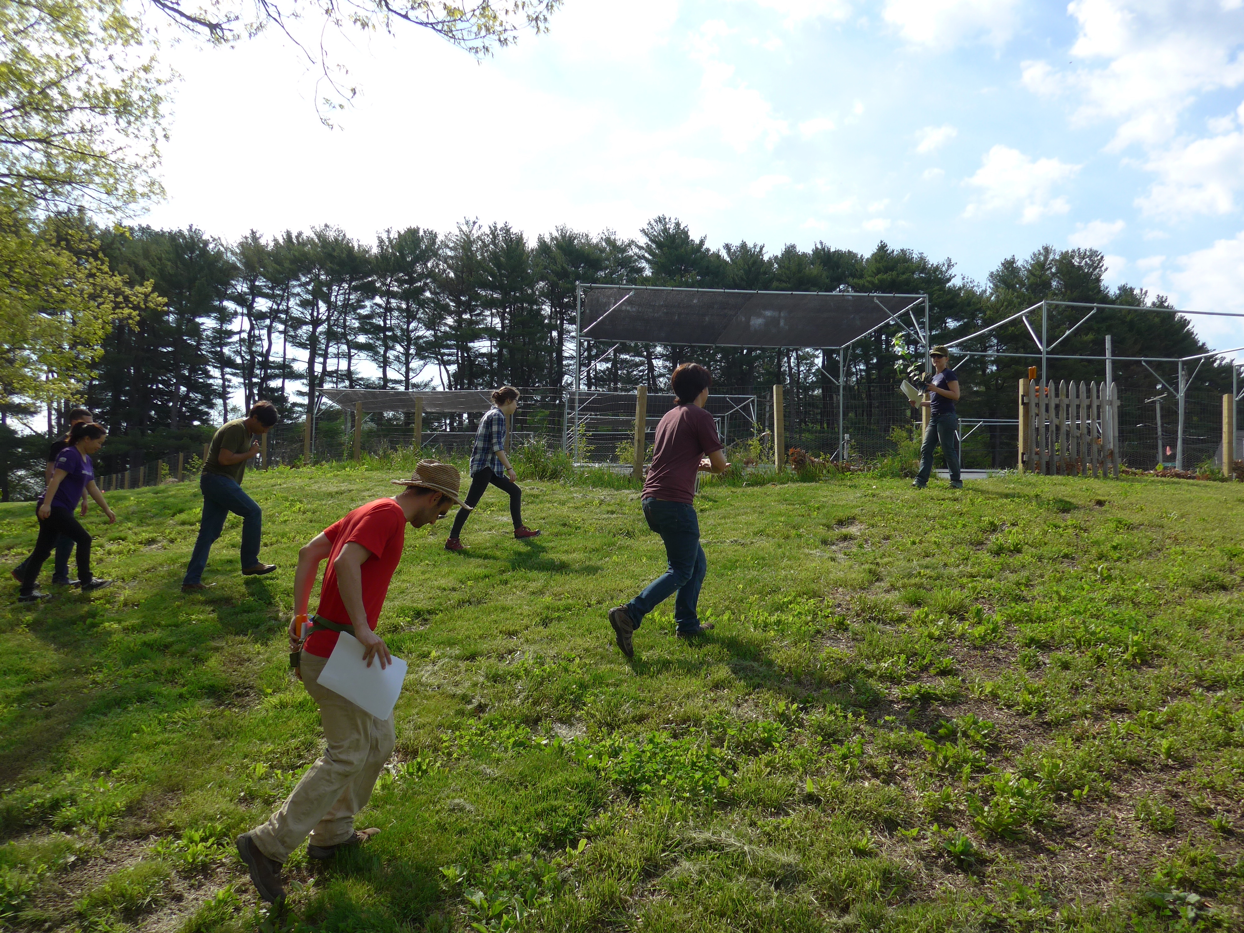

Slide 7
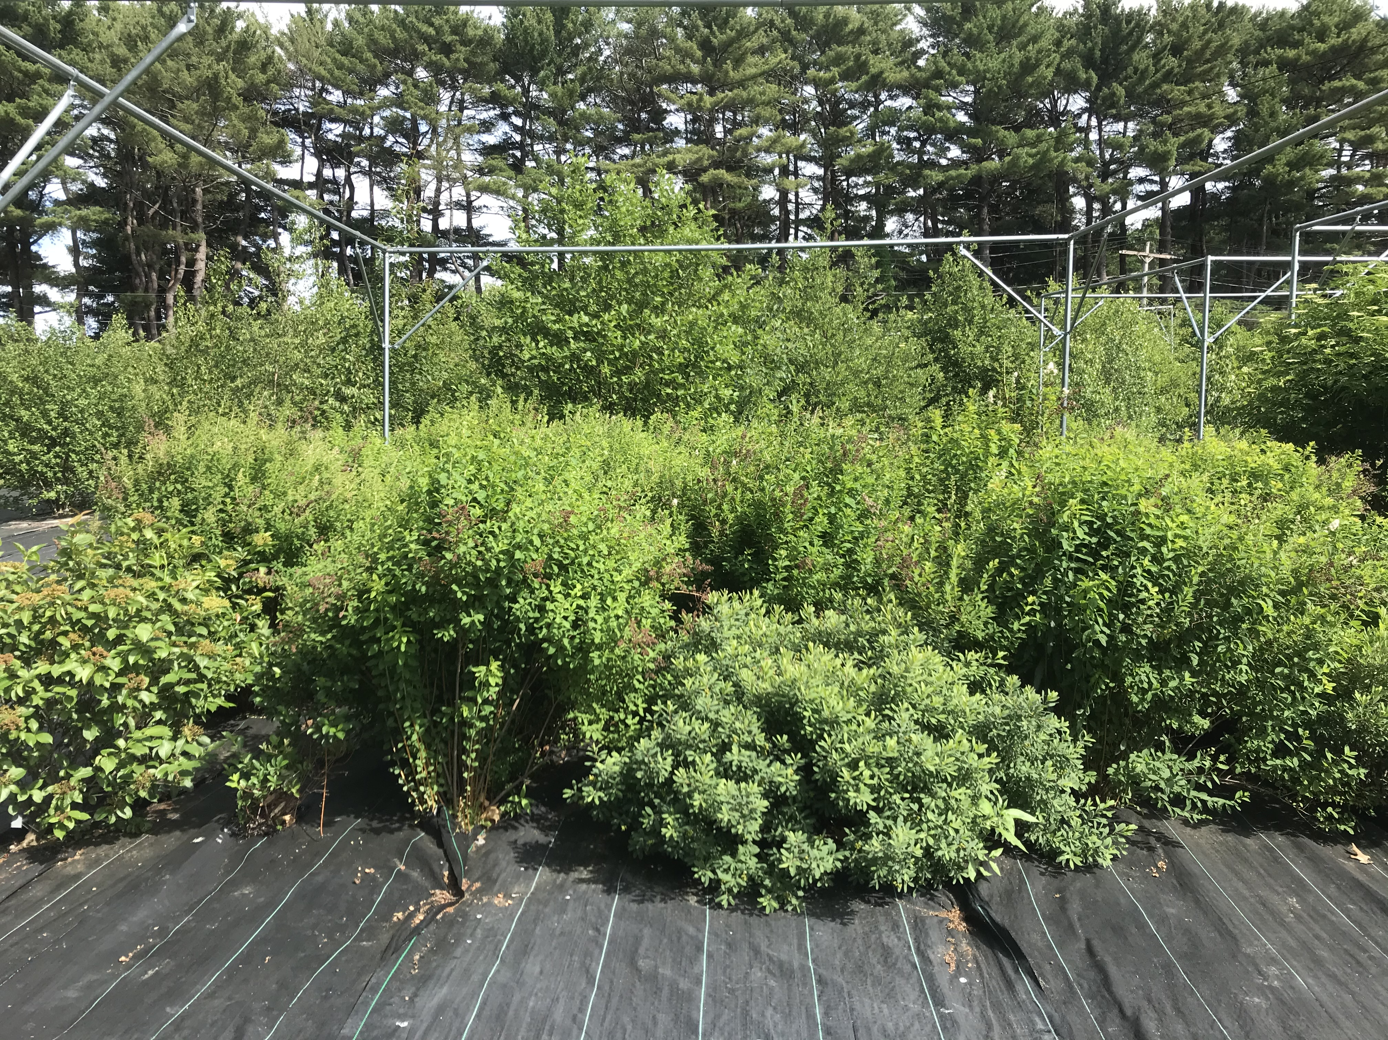
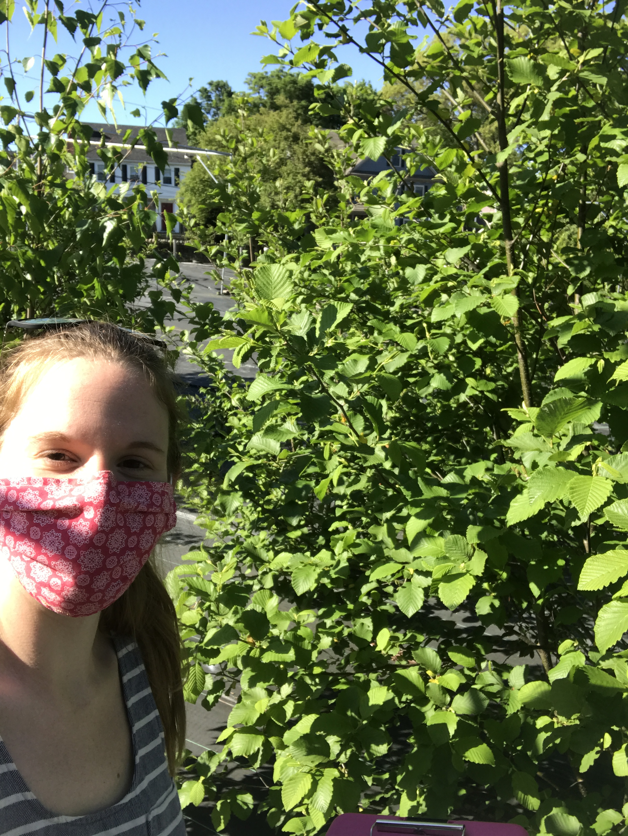
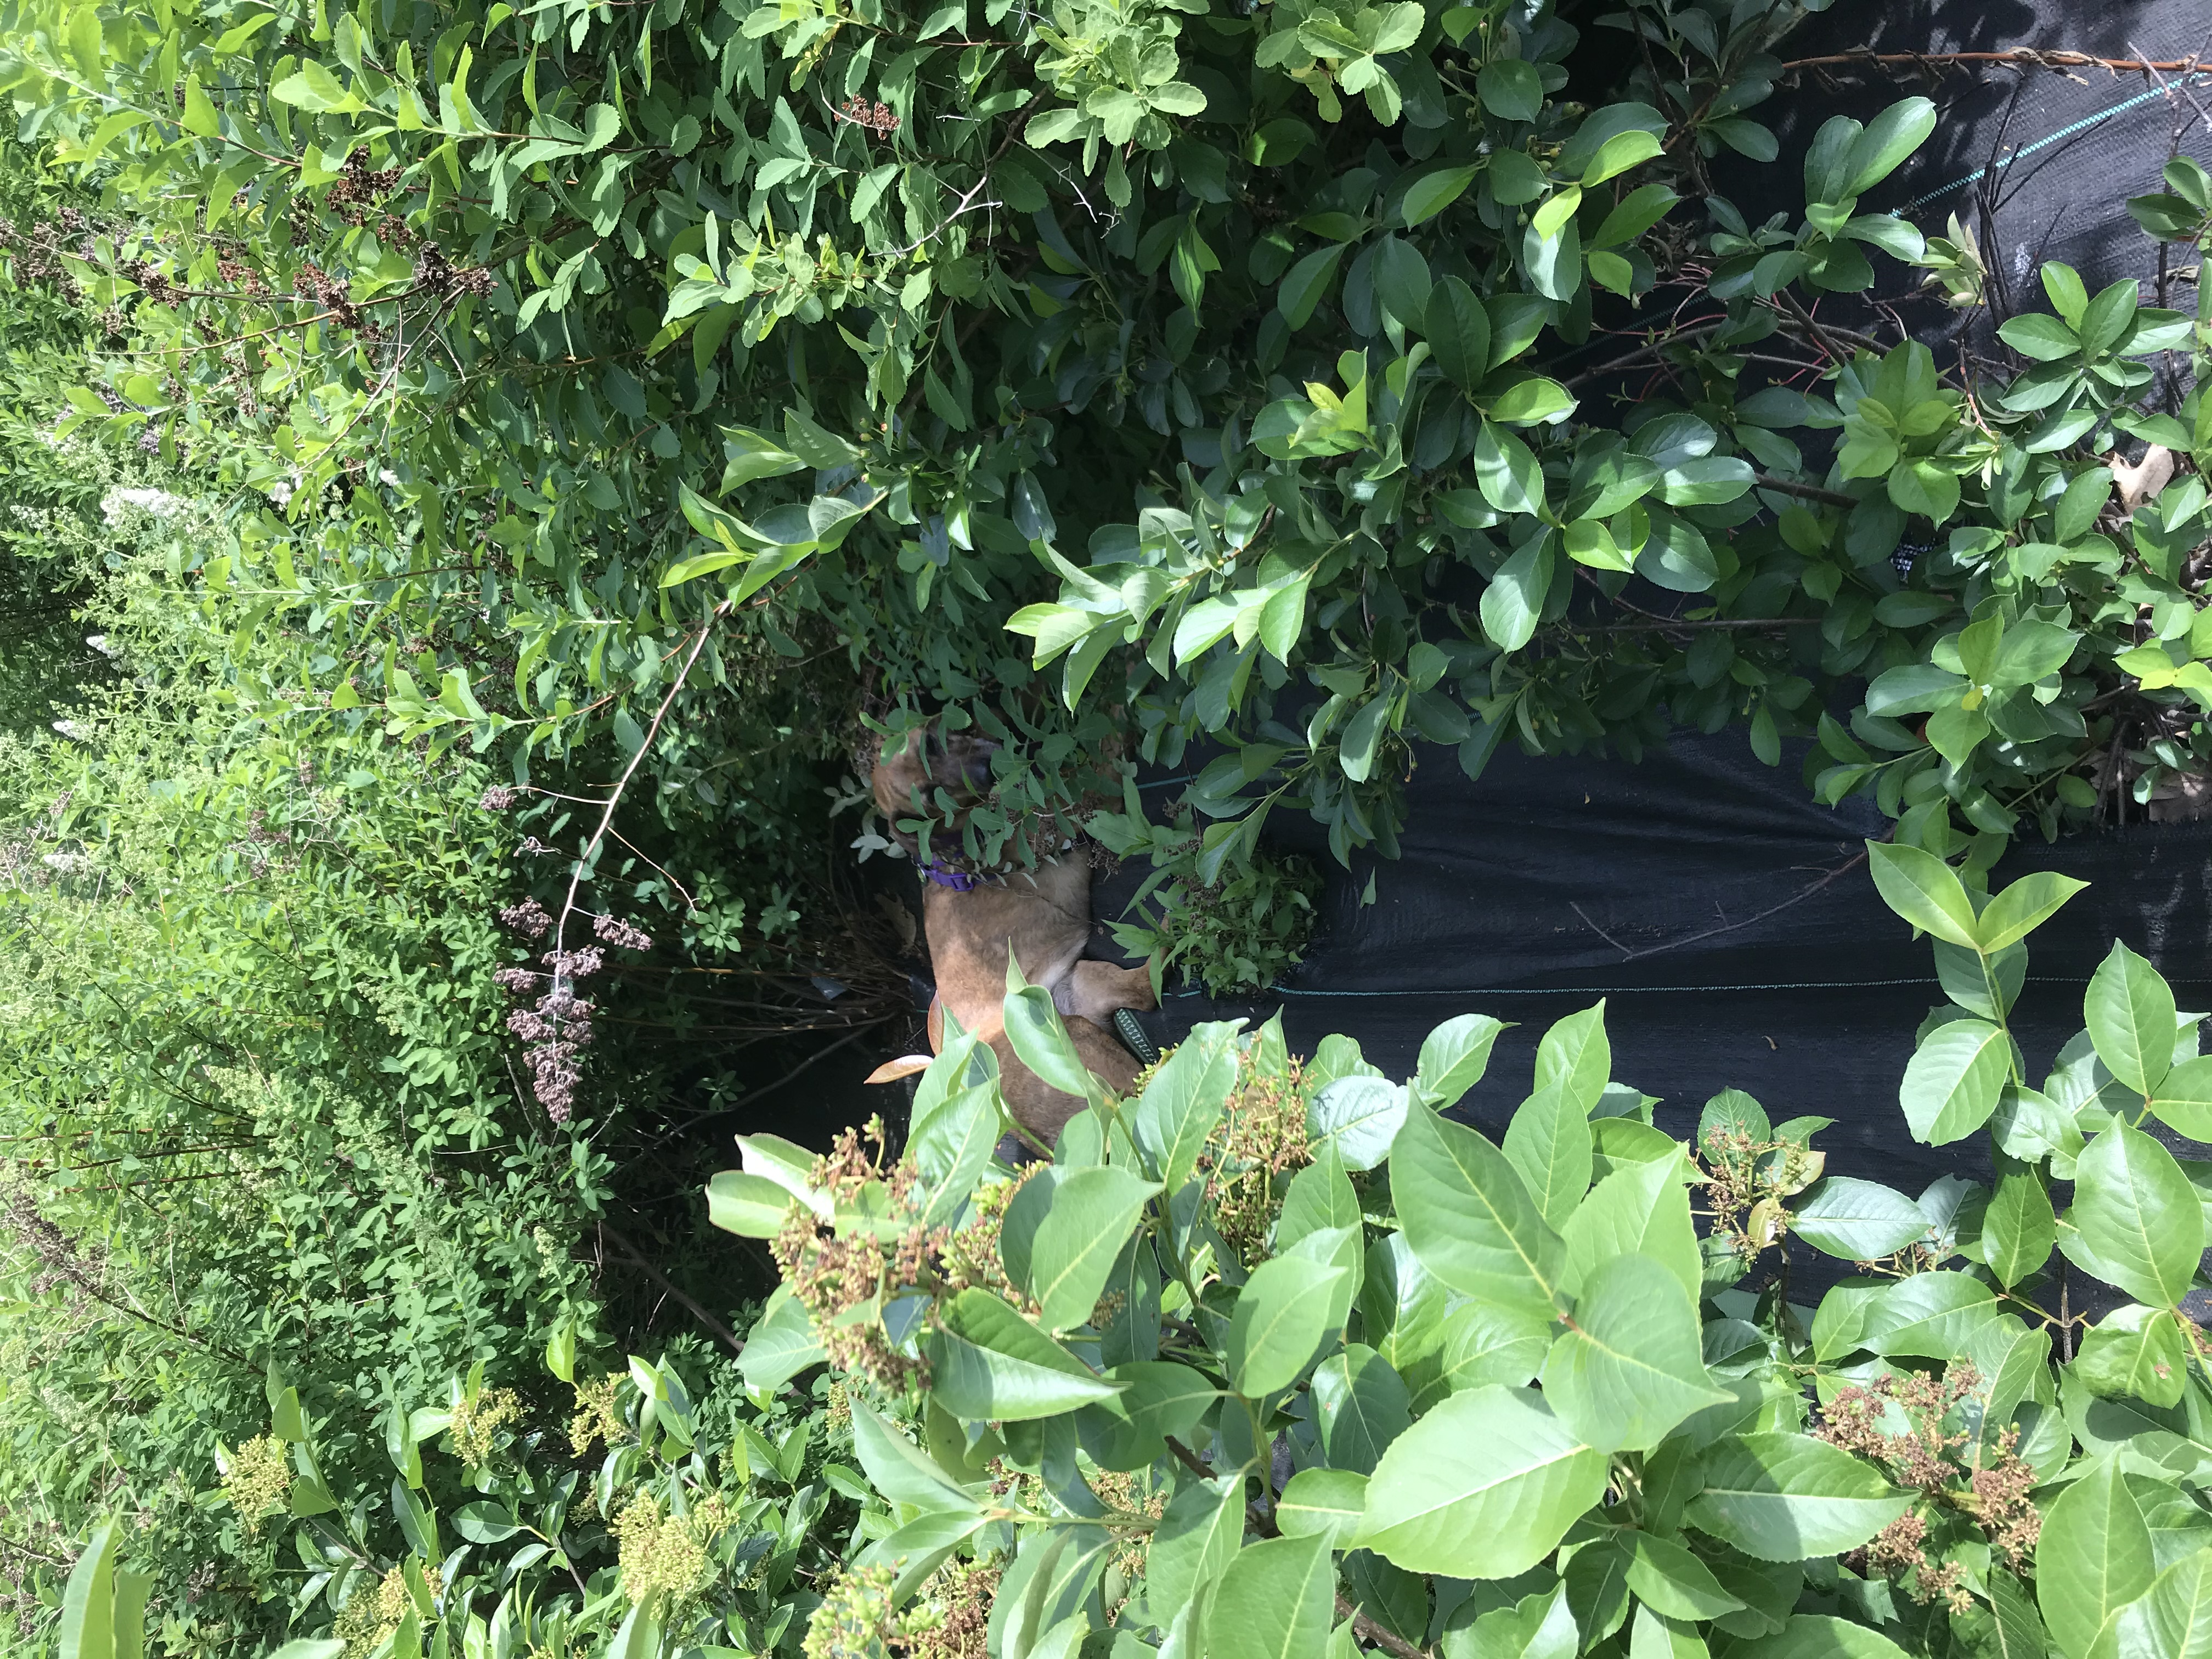

Slide 8
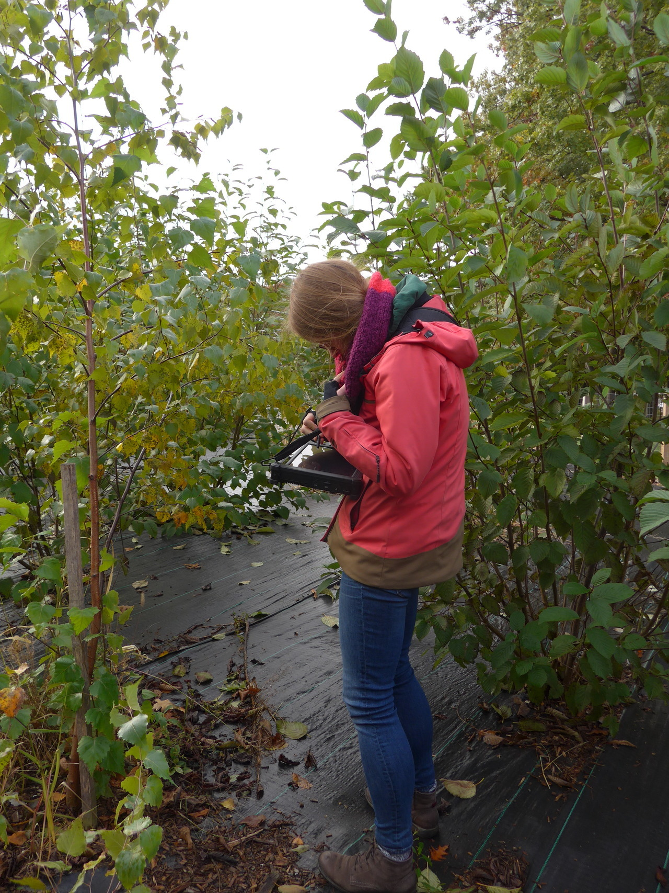
Budburst to Budset to Leaf Drop
Dan and I (plus many interns) have been recording every year from end of Feb/early March through mid November 2018-2020.
We have leafing, flowering, fruiting, and end of season data for each of those years
Two years of SLA and one year of relative growth rate

Slide 9
Interphenophase Duration
We are interested in how early phenophases influence later phases
What percentage of a season plants invest in fruiting and flowering
Early flower budburst invest less?
How does MST and over winter chilling influence the rate of leafout?
Inter vs intra—specific variation
Maybe some trait stuff..

Slide 10
Question 1: Rate of leafout
Parameters: Mean spring temperature, Mean tmin winter temperature
Three levels of hierarchy: species and population
Tmean
Feb-June
Tmin
Sept-Feb

Slide 11
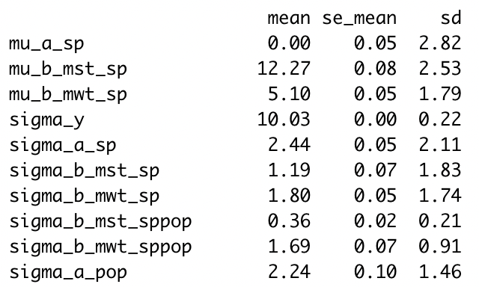
Answer 1: Rate of Leafout
Spring
Winter

Slide 12
Question 2: Flower-Leaf Sequences
Parameters: Mean spring temperature, Mean tmin winter temperature
Three levels of hierarchy: species and population
Tmean
Feb-June
Tmin
Sept-Feb

Slide 13
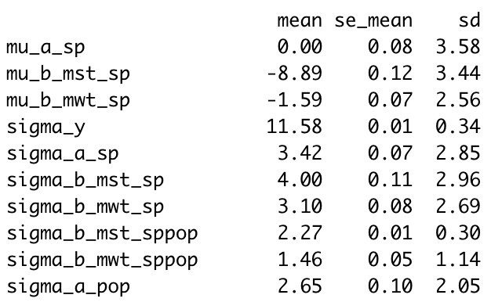
Answer 2: Flower-Leaf Seq
FLS = Flowering.time – Leafout.time
Spring
Winter

